Slide 1

Federated Garden Clubs of CT, activities and relation to Garden Club of New Haven
Archival Moment Presentation
6 February 2023

Slide 2
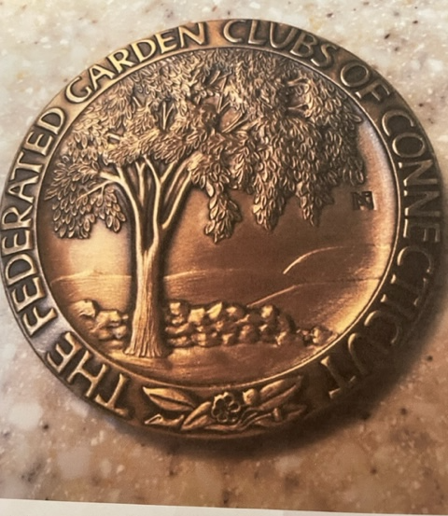
Award Winning Initial Seal of FGCCT 1930, Designed by Garden Club of New Haven
Bronze seal

Slide 3
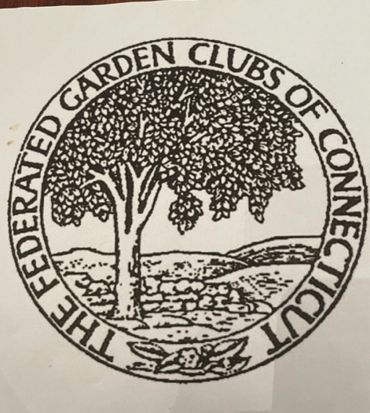
Several other logos of FGCCT

Slide 4
Federated Garden Clubs of CT website
All members of Federated Garden Clubs have access to the members section of the website. The address is www.ctgardenclubs.org
The user name is FGCCT
The password is Charteroak*2022

Slide 5
Activities of FGCCT
      Youth Activities gardens, growing food, Scholarships for college students
      National Blue Star Memorial honoring veterans

Slide 6

Youth planting activities

Slide 7
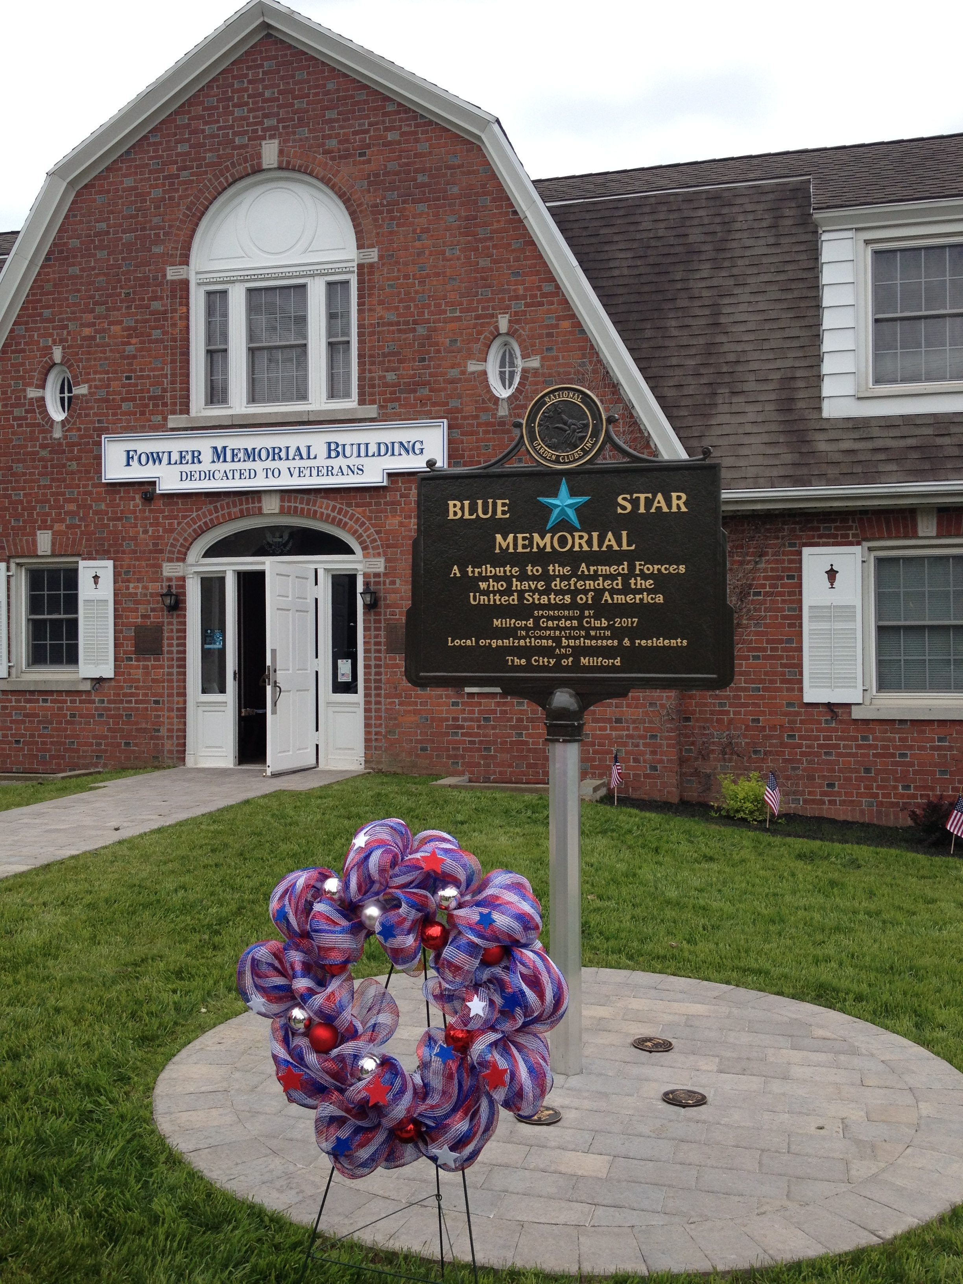
Blue Star Memorials

Slide 8
Tour Activities of FGCCT
FGCCT offers 6-8 tours every year to members, with a focus on gardens, landscaping, history, architecture, flower shows and great food!
www.ctgardenclubs.org/events-overview/tours/ Kathy tours@ctgardenclubs.org
Scheduled tours:
Charleston – March 2023
Madrid y Andalusia May 2023
    Gardens of the Hudson June 2023
    Le Marche, Italy – August 2023
    Nova Scotia & Prince Edward Island August 2023
    South Africa & Victoria Falls November 2023
    Galapagos January 2024

Slide 9
FGCCT Publications
FGCCT and NGC offer its Members a variety of publications:
  The CF News
  The National Gardener
  NGC Keeping in Touch newsletter
  New England Newsletter “Northern Exposure”

Slide 10
FGCCT Meetings
Spring Annual Meeting/Luncheon
Fall Annual Awards Meeting/Luncheon
Club Presidents’ Day
New England Annual Symposium
CT Flower Show

Slide 11
FGCCT Educational Programs
      Landscape Design School
      Environmental School
      Flower Show School
      Gardening School

Slide 12
FGCCT Awards to GCNH
.
Archival Moment Garden Club of New Haven 2023 AWARDS to GCNH from FGCCT
1934 – Federated Garden Clubs of CT Award for prizewinning design for CT state seal
1956 - Federated Garden Clubs of CT Award for planting plan for New Haven Green and Edgewood Mall 1
1971 - Federated Garden Clubs of CT Award for Flower Show
1984 – Awards for historic preservation from National Council of State Garden Clubs and Federated Garden Clubs of CT. Phelps Triangle awarded Landscape Critics Council Award for Excellence in Design by Federated Garden Clubs of CT.
1987 – Mary Stone Garden Therapy Award from National Council of State Garden Clubs and Award of Excellence in Garden Therapy from Federated Garden Clubs of CT
INDIVIDUAL AWARDS – Mrs. Roscoe Suttie 1991 - Ellen Carver Memorial Horticultural Award from the Federated Garden Clubs of CT
Club Certificate of Achievement – Conservation 2021 The Garden Club of New Haven chose the book All We Can Save: Truth Courage and Solutions for the Climate Crisis by A.E. Johnson and K.K Wilkinson for the Conservation Committee to Read. The entire club was invited to read and joined in an inspired review and conversation.
Club Citations – 2021 Conservation Members of the Garden Club of New Haven have been invited to sign and commit to a Healthy Yard Pledge. They are committed to managing their gardens and yards while limiting synthetic pesticides, weed killers and fertilizers to improve habitat for native plants and wildlife.

Slide 13
Garden Club of New Haven Archival Moment Narrative
Federated Garden Club of CT (FGCCT)
6 February 2023
[Slide #1: Logos of both GCA and FGCCT]
1. Overview of GCA and NGC
Zones vs Federations
The Garden Club of New Haven is a member of the Garden Club of America (GCA) and the National Garden Club (NGC). Many clubs are members of both, pay dues to both, and enjoy the benefits of both. The United States is divided into segments under both organizations. In GCA we are in Zone II -comprised of CT and Rhode Island. There are 12 GCA zones for the country.
We are also members of NGC, as the Federated Garden Clubs of CT. Under NGC, every state has a Federation of Garden Clubs – each state may title its Federation of clubs slightly differently. Names of the 50 or so Federation Members may vary such as:
Federated Garden Clubs of CT
Garden Club Federation of PA
Texas Garden Clubs, Inc
All 50 states each have a garden club Federation, and together they make up the National Garden Club.
The Garden Club of New Haven was instrumental in bringing the 12 existing CT garden clubs together to form the Federation. Mrs. John Demarest, who was the first FGCCT president, was a founding member of the Garden Club of New Haven. Over the years, four of the FGCCT’s presidents have been members of our New Haven Club.
[Slide #2: Original Seal of FGCCT]
In 1934, the GCNH won an award for the design of the original seal of the FGCCT. This was struck in bronze, which didn’t make it easy to use on correspondence.

Slide 14
[Slide #3: 2 additional seal designs]
Over the years there were additional Seals created and used
[Slide #4: today’s seal]
This is the current logo of the FGCCT.
The Federated Garden Clubs of Ct has a Board of Directors comprised of members from 21 of the 117 clubs. The Board meets every other month, usually here at the Ag Station or on Zoom.
Member involvement is always welcome in a wide range of areas. You can review these by looking at Federated Garden Club of CT website under the members area.
The address is www.ctgardenclubs.org The sign in and password is in your GCNH directory. It includes lots of information about their activities.
Some of the areas of particular strength and involvement include:
[Slide #5: Youth Activities]
Every club in the Federation may establish a Youth Garden Club, and many do. Activities include seed saving, Community gardens, food banks, 4H, Future Farmers of America, Scouts, and Master Gardeners, to name a few. Garden clubs go into schools to help start pollinator gardens, vegetable and flower gardens, therapy gardens and they also teach farm to table. We believe in this very strongly as once you involve a child or teen in a garden you have them looking at our earth in a more thoughtful way forever.
Scholarships are awarded to high school students, college students, Ag station summer interns and NGC school attendees with focuses on garden, environmental, landscaping or community improvement plans or projects.
National Blue Star Memorial pays tribute to all men and women who have served, serve now or will serve in US Armed Forces. FGCCT has 15 Blue Star memorials in CT

Slide 15
[Slide #6: FGCCT Tours. https://ctgardenclubs.org/events-overview/tours/
FGCCT offers its members 6-8 tours a year. They focus on gardens, landscaping, history, architecture, flower shows and of course, great food.
For example, as we begin to venture out again, Savannah and the low country is in April, Alaska is in August and Le Marche, Italy is later in the fall. In 2023 we are working on private garden and birding tour in Costa Rico, the Charleston Home and Gardens tour, Madeira Flower Show, a Hudson Valley trip, Nova Scotia in late August, South Africa in November and a 3 night trip to Longwood Gardens for the Christmas time. These trips are developed for our members, family, and friends and give us all opportunities to get to know each other and travel together as a small group. It’s always fun, friendly, and fairly priced.
[Slide #7: Publications]
The CF News: This is the CT Federated Garden Clubs newsletter that goes by email to every Federated garden club member. The news comes out every other month and provides a variety of information and a calendar of events from many of our clubs.
The national magazine, The National Gardener, is available free on the NGC website, www.gardenclub.org under member resources.
There is the NGC Keeping in Touch newsletter, about local and national matters, schools, achievements, and special events, which brings you up to speed between the quarterly editions of the National Gardener.
Additionally, there is the New England Newsletter “Northern Exposure” as well as the FGCCT Annual Report.
All of these publications help to connect us to opportunities, updates on issues, as well as special events, which are open to all members.
[Slide #8: Meetings]
Spring Annual Convention, at a member club and the Fall Board meeting at NGC headquarters in the NGC owned building adjacent to the St Louis Botanical Gardens. Any garden club member may attend these events.

Slide 16
.
CT Awards Day – many, many clubs and members receive awards in a number of areas ranging from civic beautification to youth involvement to highway markers to environmental activism, education, pollinator pathways, conservation efforts and horticulture therapy. This luncheon is open to everyone.
Annual luncheon – always a fabulous speaker, special presentations such as a design challenge or chrysanthemum contest, and good venders with all sorts of garden items from tools to containers to perennials. It’s open to all members.
Presidents Day – all club presidents get together for a day of learning about new NGC offerings, retain members, learning opportunities.
FGCCT BOD Bi-monthly meeting
New England Annual Symposium – where you will hear from sister states, and they also have a flower show.
[Slide #9: Education Programs]
National Garden Club’s education courses offer a unique opportunity to its members. These schools are:
Gardening School,
Landscape Design School,
Environmental School
Flower Show School.
Garden, Landscape and Environmental Schools offers 10 hours of classroom and field trip education, as a series of 4 courses, which may be taken in any order over 4 years, one segment each year. All states are encouraged to offer these schools, and I’m proud to say that Federated Garden Clubs of CT is one of the few states that offers all 4 schools every year. This is no small feat!
All four of these schools lead to certification or accreditation in each area of study. The instructors are all NGC approved and are recognized experts in their fields.
Please visit the FGCCT website to get more information about these classes.

